Slide 1
Advanced C++ Internals: Chapter 2 Binary Tools
ZACOCPPINT

Slide 2
Learning Journey:
Debugging
SRE
Overview of GBD Demonstration
Overview of Ghidra
Demonstration
Useful Cheat Sheets
Lab #2
Summary
Appendices:
Useful links
Learning Outcomes:
Must be able to identify the purpose of debugging and SRE
Should be able to describe key features of leading debug and SRE tools
Could be able to use appropriate tools to perform debug and SRE on targeted executables
Binary Tools

Slide 3






Debugging is the process of identifying and fixing errors in software
Key utilities include:
Debugger, e.g. GDB (GNU Debugger)
Static Analysis Tools, e.g. Linters etc.
Profilers, e.g. Valgrind
Logging Libraries, e.g. Boost.log
Key debugging processes include:
Reproduction of error
Isolation of error
Setting Breakpoints
Inspection/Watch of variables
Stack Trace
Version Control
Testing and Documentation
Debugging

Slide 4





SRE is Software Reverse Engineering
SRE has three core objectives:
Understand a binary’s functionality
Understand a binary’s structure
Understand a binary’s behaviour
Key processes include:
Static analysis
Dynamic analysis
Code Disassembly
Reversal of code logic and flow
Function Identification
Memory Analysis
Pattern Recognition
Key SRE tools include:
IDA Pro (commercial)
NSA’s Ghidra (open source)
Radare2 (open source)
SRE

Slide 5

Part of GNU Project, so stablemate of GCC
Dates to 1986; so, tried-and-tested
Supports many languages, including C, C++, Fortran, and Ada
Crucial tool in software development process
Often integrated with IDEs
GDB (GNU Debugger) key skills:
Set breakpoints
Inspect variables
Step in/over code
Backtrace (call stack)
Inspect Memory
Modify Memory
Analyze core dumps (from crashed executables)
Overview of GDB

Slide 6
Demonstration
GBD

Slide 7

Developed by NSA (National Security Agency)
Release in 2019 to public after decade or so internal use
Regular updates from open-source community
Supports multiple architectures (native build of components)
Key tool for security researchers and reverse engineers
Ghidra key skills:
Disassembly
Decompilation
GUI use
Binary Analysis, e.g. function and type identification
Commenting and labelling
Code patching
Scripting (for automation)
Collaboration features (for multiple analysts)
Debug (later versions; adds Dynamic Analysis)
Overview of Ghidra

Slide 8
Demonstration
Ghidra

Slide 9
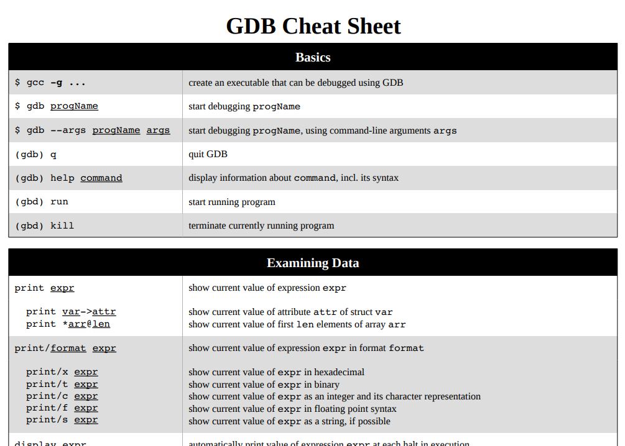
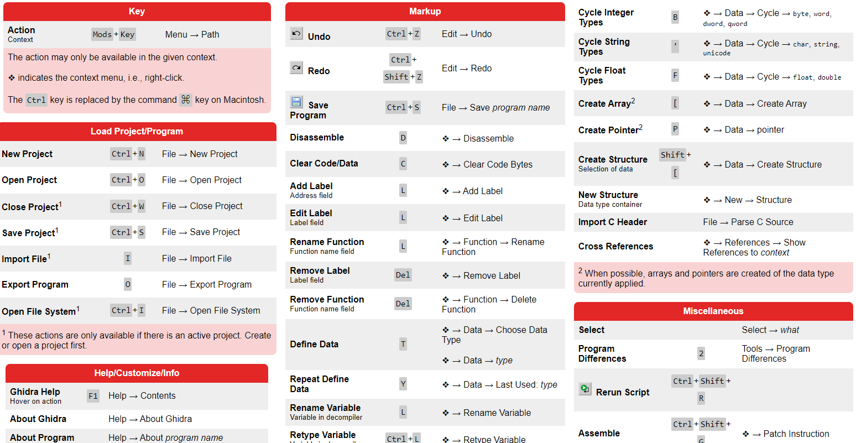
For quick reference:
https://gabriellesc.github.io/teaching/resources/GDB-cheat-sheet.pdf
https://ghidra-sre.org/CheatSheet.html
Useful Cheat Sheets

Slide 10
C++ Internals Lab #2
Using open-source tools to investigate a binary object
Notes:
This lab focuses on using open-source tools to investigate a binary object

Slide 11
Summary
Various tools are available to examine binary executables
for security researchers and reverse engineers
These include Debugging and SRE tools
Some are commercial, e.g. IDA Pro
Most are open-source, e.g. GNU GDB, NSA Ghidra
Many support multiple languages and architectures
But may require build of native components during installation.
Each tool has key skills that should be mastered
Some aspects may need to be manually built for specific architecture support
Challenges can occur depending on the original source code language.

Slide 12
Any questions?

Slide 13
Appendices
Notes:
Some additional information you may find useful…

Slide 14
Websites and online resources
GCC, the GNU Compiler Collection (no date) GCC, the GNU Compiler Collection - GNU Project. Available at: https://gcc.gnu.org/ (Accessed: 16 November 2023).
GDB: The GNU Project Debugger. Available at: https://sourceware.org/gdb/ (Accessed: 28 December 2023).
Ghidra. Available at: https://ghidra-sre.org/ (Accessed: 28 December 2023).
radare. Available at: https://www.radare.org/n/ (Accessed: 28 December 2023).
A list of open source C++ libraries (no date) cppreference.com. Available at: https://en.cppreference.com/w/cpp/links/libs (Accessed: 28 December 2023).
GDB Cheat Sheet . Available at: https://gabriellesc.github.io/teaching/resources/GDB-cheat-sheet.pdf (Accessed: 28 December 2023).
Ghidra Cheat Sheet. Available at: https://ghidra-sre.org/CheatSheet.html (Accessed: 28 December 2023).
Useful resources

Slide 15
Review of Chapter’s Learning Outcomes

Slide 16
Learning Outcomes:
By the completion of this chapter, you…
Must be able to identify the purpose of debugging and SRE
Should be able to describe key features of leading debug and SRE tools
Could be able to use appropriate tools to perform debug and SRE on targeted executables
Please review these learning outcomes at chapter's end.
Learning Outcomes

